Slide 1
Waterway-sunrise-i_656A

Slide 2
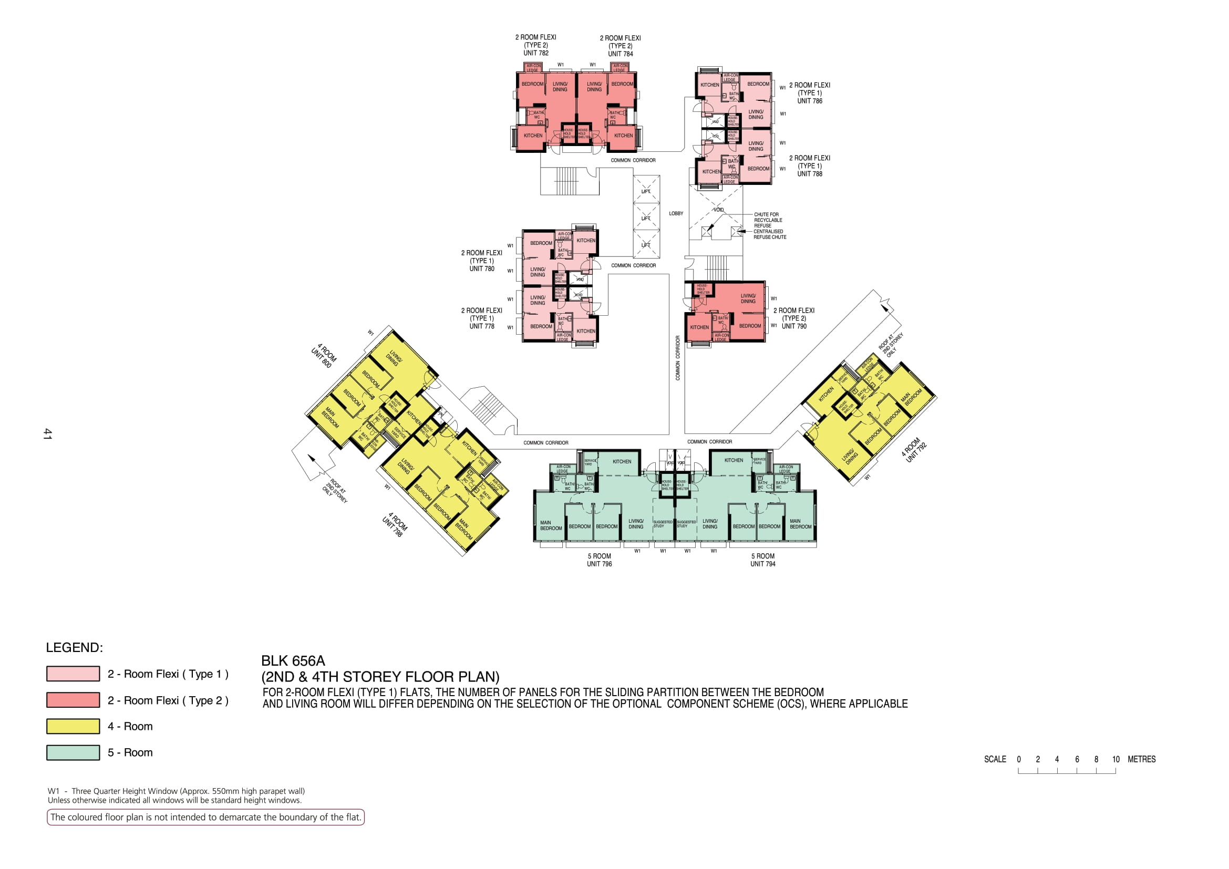

Slide 3
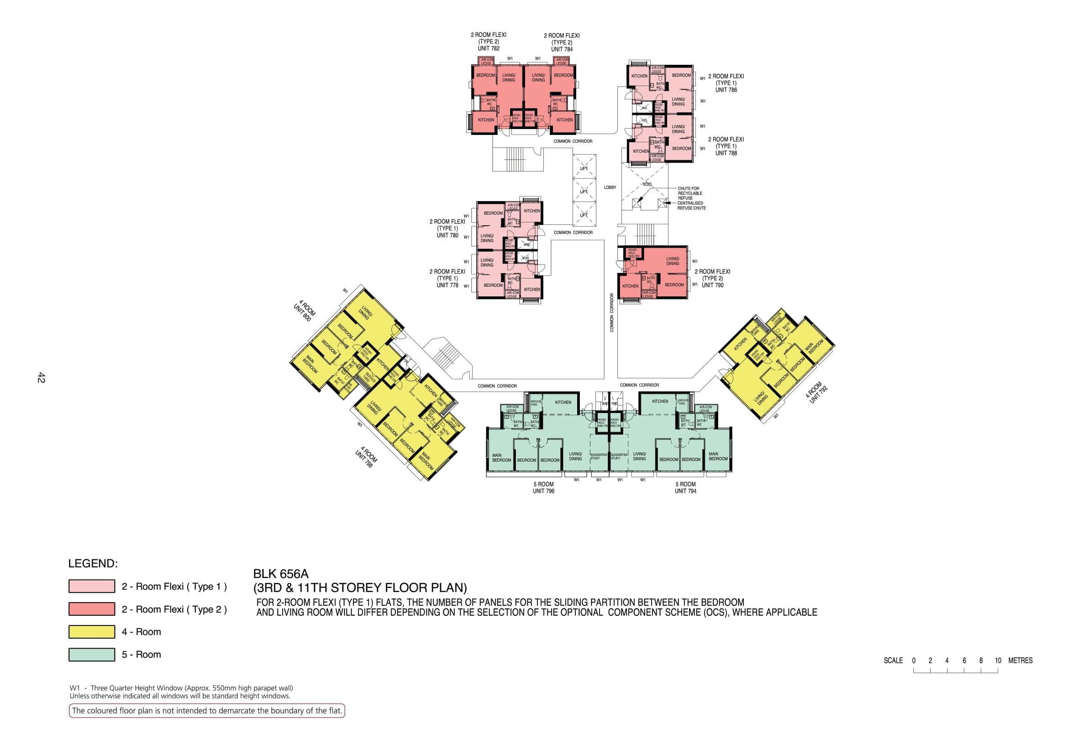

Slide 4
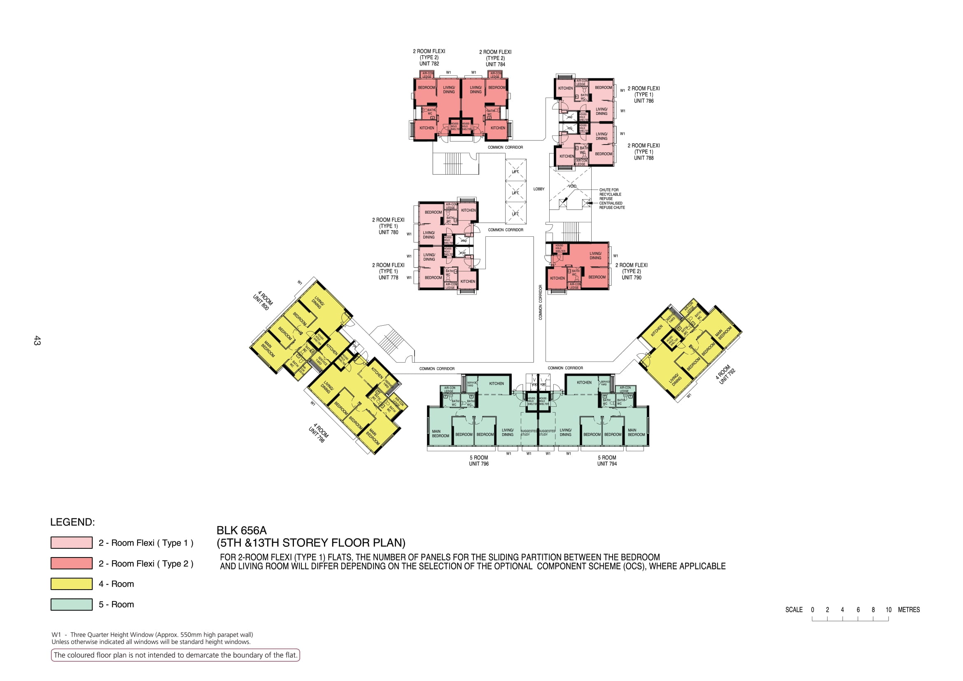

Slide 5
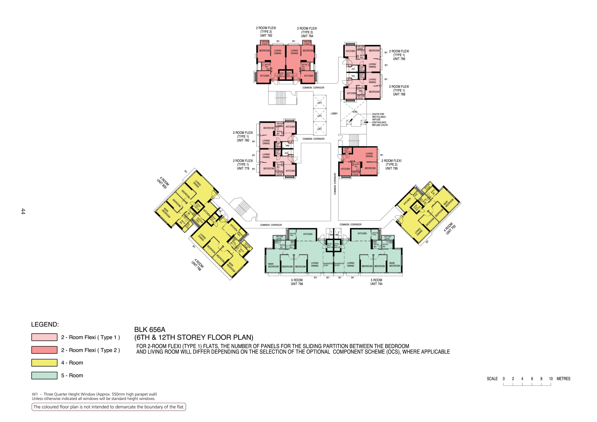

Slide 6


Slide 7
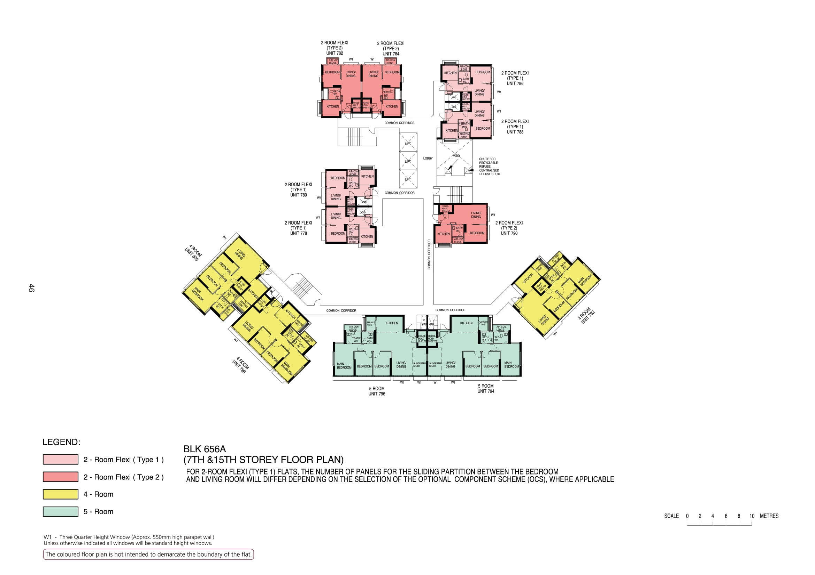

Slide 8
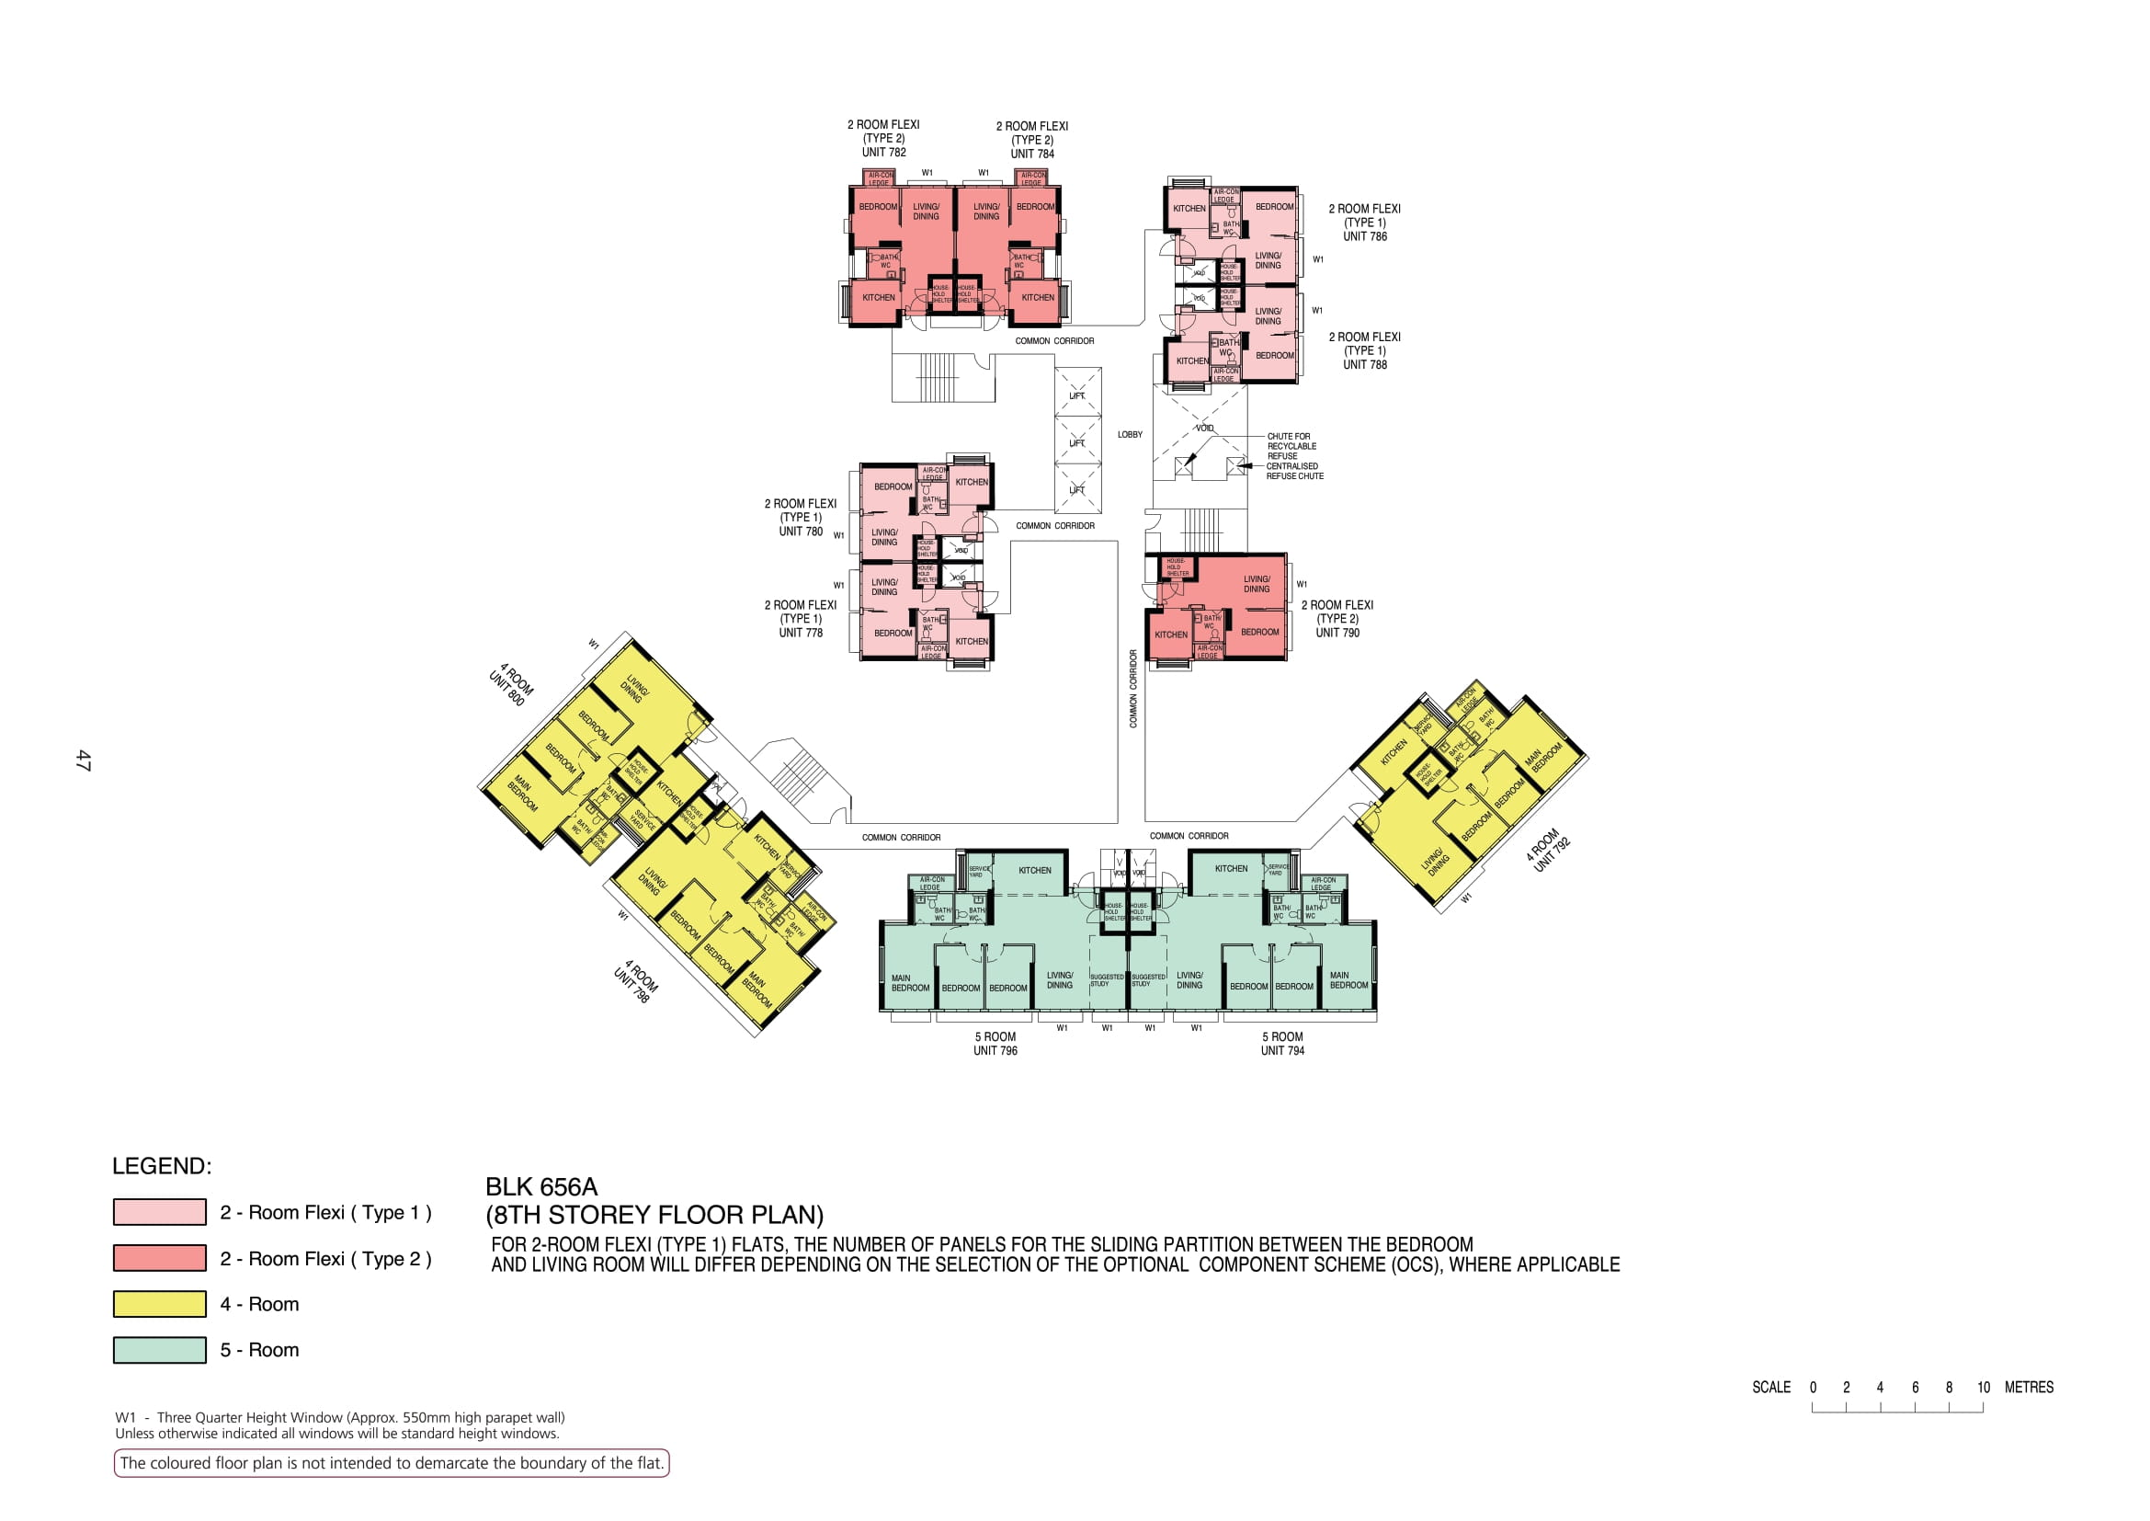

Slide 9
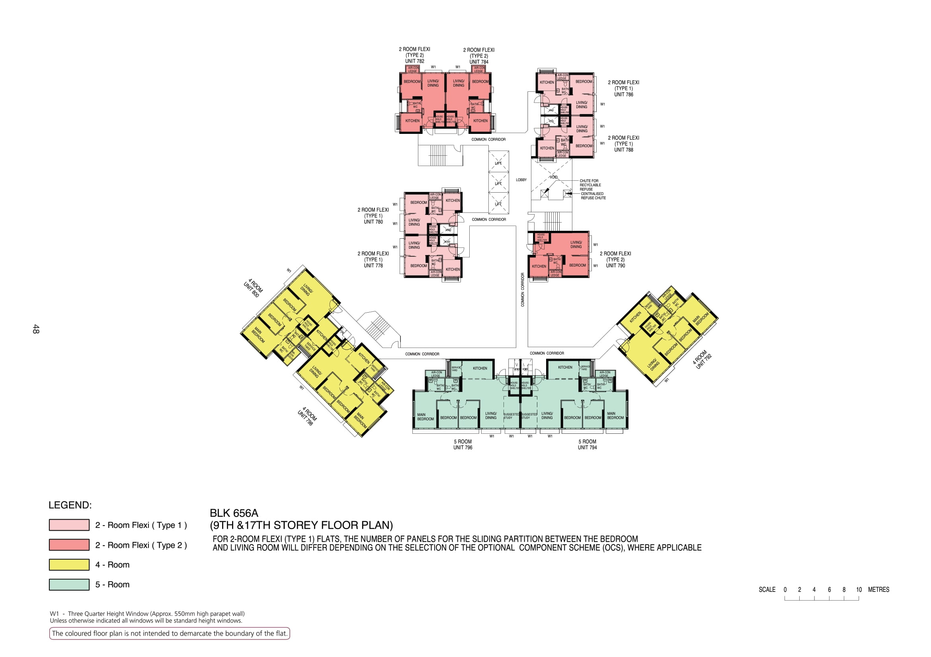

Slide 10
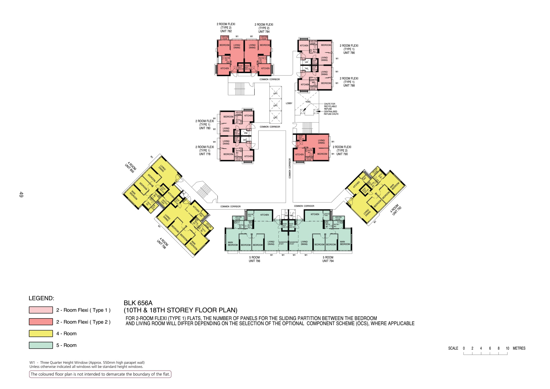

Slide 11
782
784
786
COMMON CORRIDOR
788
LOBBY
780
COMMON CORRIDOR
778
790
COMMON CORRIDOR
800
792
COMMON CORRIDOR
COMMON CORRIDOR
798
796
794

